Slide 1
Learning to code while doing your day job
Damian Karlson
Brent Piatti

Slide 2
The IT world has changed
Hyper-convergence has merged silos
Infrastructure & platform as a service has put the focus on running IT as a business
Public cloud technologies are easy to consume
Business agility is key
Regulatory-unnecessary silos encourage kingdom building and "us vs. them" mentalities
Effective & timely delivery of applications requires development & operational changes

Slide 3
New skills are required
Windows IT Pro report
most in-demand skills include open source tools, configuration management systems, programming platforms, and knowledge of development operations
Siloed skills are great, but there is a shift towards a broader understanding of IT architecture & agile processes
Not every company is able to spend time & money on training in-house folks
Hiring outside talent is an option, but not always the best option
Soft skills and the capacity to learn & apply new technologies is critical

Slide 4
Key concepts
Infrastructure as code
DevOps & collaboration
Learning to code
Resources

Slide 5
What is infrastructure as code?
Writing code to manage configurations, automate provisioning of infrastructure and application deployments
More than just scripting or infrastructure automation; incorporates software development processes
Write code to provision and manage your server/VM/etc.
Version control (easily track changes and provide a rollback path), testing, small deployments
Configurations can be consistently repeated, tested, easily shared, and promoted
Self-corrects to desired state
Becomes executable documentation
Descriptive languages and flat text files are easy to understand
Ex: Puppet, Chef, Ansible

Slide 6
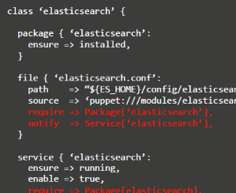

Infrastructure-as-Code
Repeatable, consistent automated configuration
DECLARE DESIRED STATE
IN READABLE CODE
3
MANAGE TO
KNOWN GOOD STATE
1
VERSION CONTROL
CODE & BINARIES
BINARY
Orchestration & Deployment Engine
Storage
Compute
Network
Middleware
Runtime
Application
CONFIG
ATTRIBUTES & METADATA
ENVIRONMENT PROFILES
PARAMETERS
2
WORK FROM
KNOWN GOOD STATE

Slide 7
DevOps & collaboration
The practice of operations and development engineers participating together in the entire service lifecycle, from design through the development process to production support.
Characterized by operations staff making use many of the same techniques as developers for their systems work.
"Dev" isn't necessarily only developers, but can be everyone involved in developing the product
"Ops" is general term for system administrators & sub-disciplines
Extends Lean & Agile approaches towards the entire IT service
FUN TIME

Slide 8
And now it’s time for a breakdown
Values
Individuals and interactions over processes and tools
Working software over comprehensive documentation
Customer collaboration over contract negotiation
Responding to change over following a plan
Principles - approaches that support these values
Methods & practices - process implementations of principles
Tools

Slide 9
Understanding sdlc
Software development lifecycle describes the process for planning, creating, testing, deploying, managing, and retiring software/applications
System administrators need to understand:
Software development toolchains that are being used by their developer end-users
Application development lifecycle (Dev => QA => Test => Prod)
Software development terms as they pertain to delivering IaaS or PaaS to developer end-users
(artifacts, builds, etc.)
Infrastructure/IT service requirements for each stage of SDLC (infrastructure as code helps!)

Slide 10
Why you should learn to code
Great way to practice precise, disciplined, abstract thinking
Understanding the end user community you're serving can benefit you professionally and personally
Emerging operating models & technologies are your responsibility to learn
Be a subject matter expert that understands the challenges facing your company's developers
Think about IT programmatically rather than "next, next, finish"

Slide 11
Why you should still learn to code
If you script (PowerShell/PowerCLI, bash, batch) or interact with REST APIs, learning to code is a minor hop
Learning languages such as python, perl, or go are directly applicable to your day job
think APIs for VMware, EMC, OpenStack, AWS, etc.
Contribute to open source projects (EMC Code, for example) based on your real world interactions & implementation

Slide 12
Convincing your boss
Good news: there are a multitude of free or very low cost learning resources available
More good news: positioning yourself for that next step in your career is a best practice

Slide 13
Resources
Codecadamy: Python, Ruby, Git
Pivotal: Introduction to Cloud Foundry
PluralSight
(VMware vExpert benefit!)
#vBrownBag TechTalks and podcast
FreeCodeCamp.com

Slide 14



‘Dis’comfort zone
Brent m. Piatti – Systems engineer
The hot aisle @Brentpiatti brentpiatti.com

Slide 15
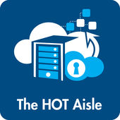


A tech podcast for you, by you

Slide 16
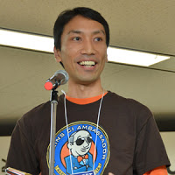








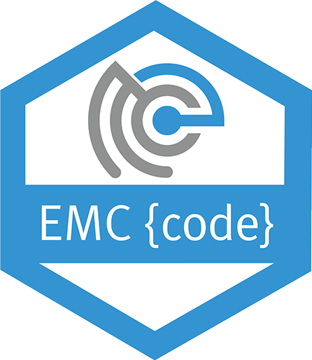

Guests
Kohsuke
Kawaguchi
Thomas
Rampelberg
Patrick
Mcfaden
Jason
Hand
Clint
Kitson

Slide 17


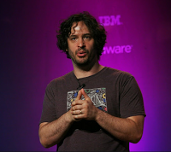


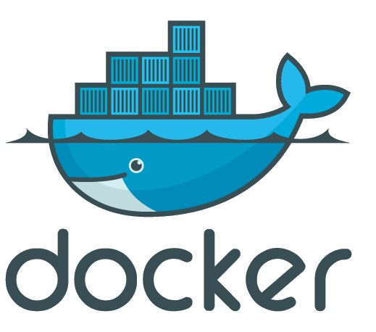






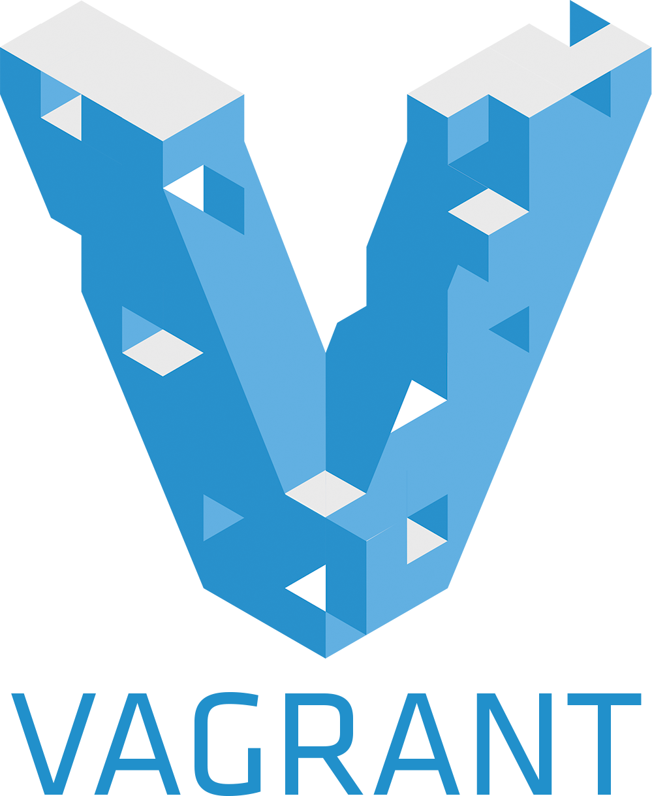
Guests
Ashley
McNamara
Steve
Francia
Andrew Clay
Shafer
Randy
Bias
Mitchell
Hashimoto

Slide 18

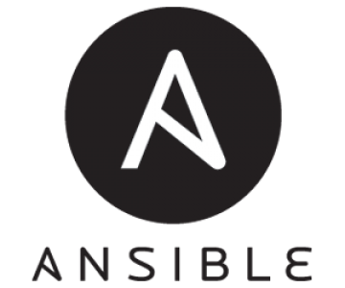
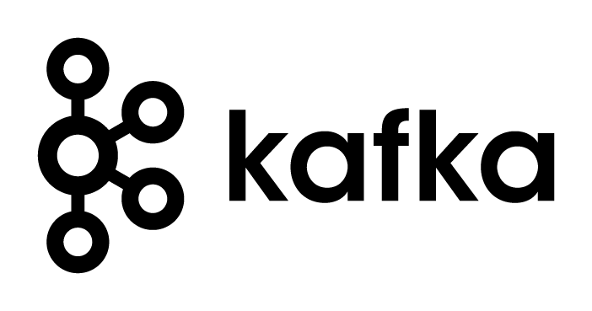

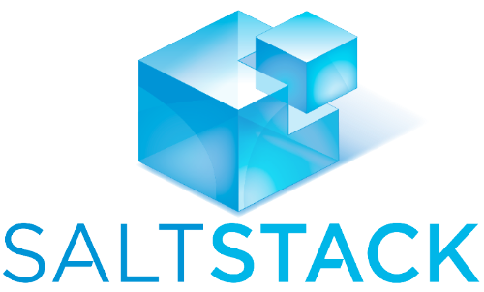

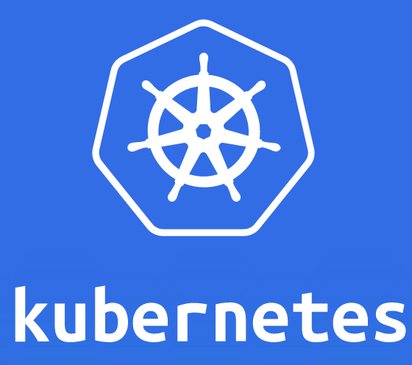




Slide 19
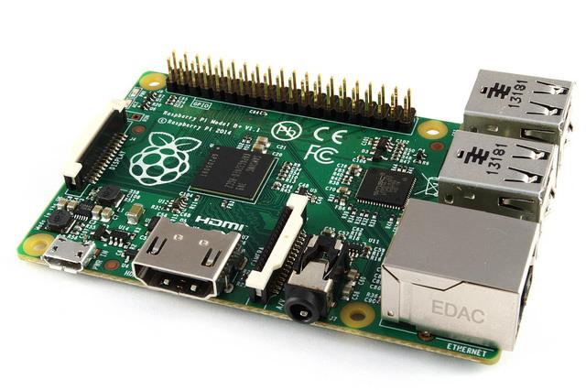


Slide 20

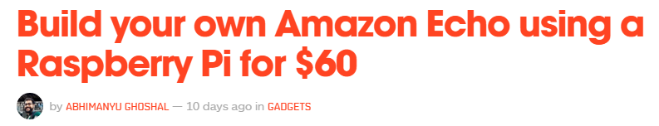

Slide 21





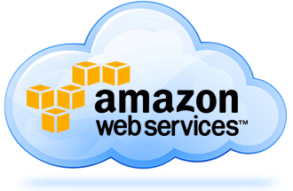


Slide 22

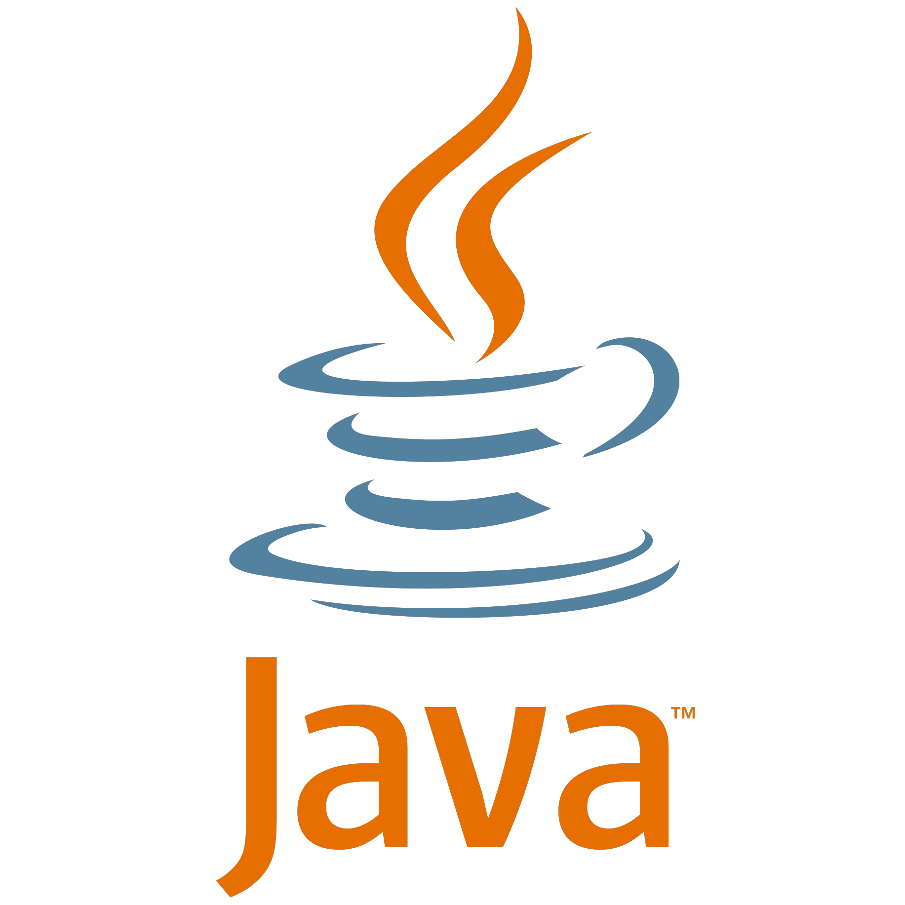



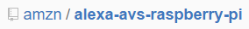

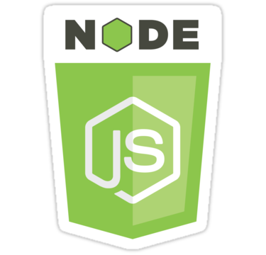


Slide 23


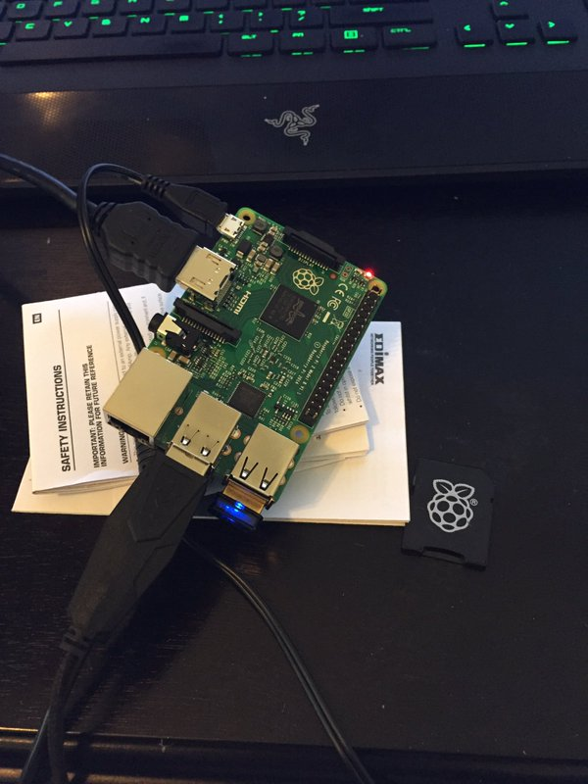
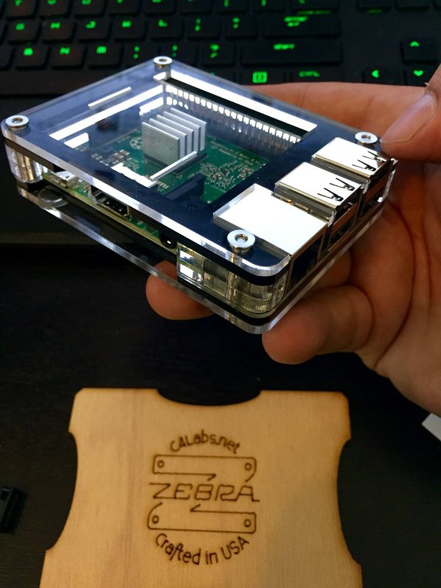
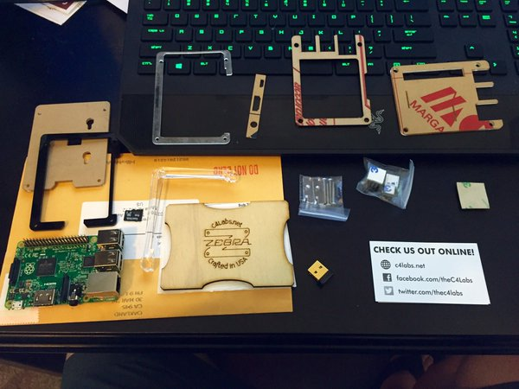

Slide 24

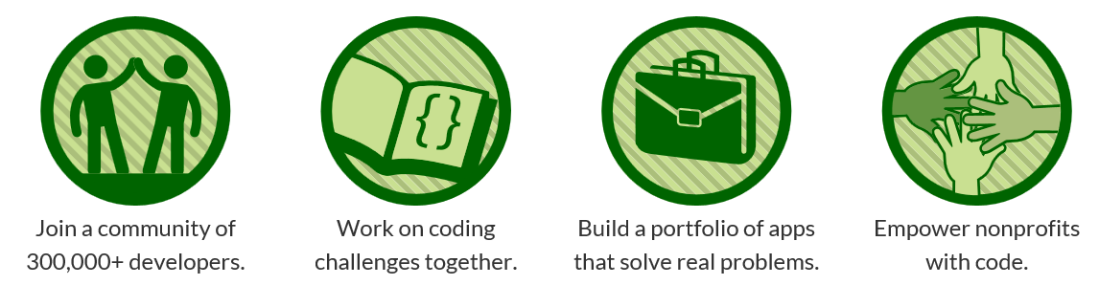

Slide 25
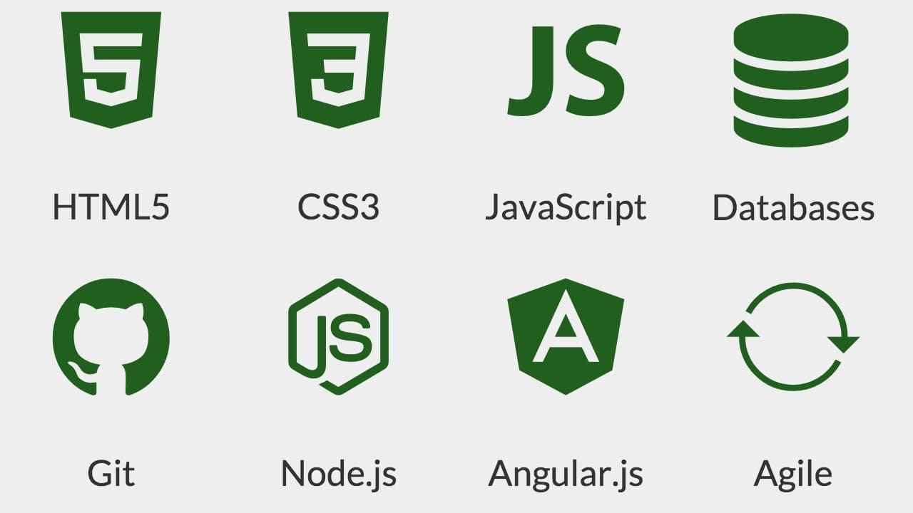
What can I learn?

Slide 26
stay busy for 1 year
52 weeks x 40hrs = 2,080 hrs of content
Certifications
Front End Development Certification (400 hrs)
Data Visualization Certification (400 hrs)
Back End Development Certfification (400 hrs)
Full Stack Development Certification (800 hrs)

Slide 27
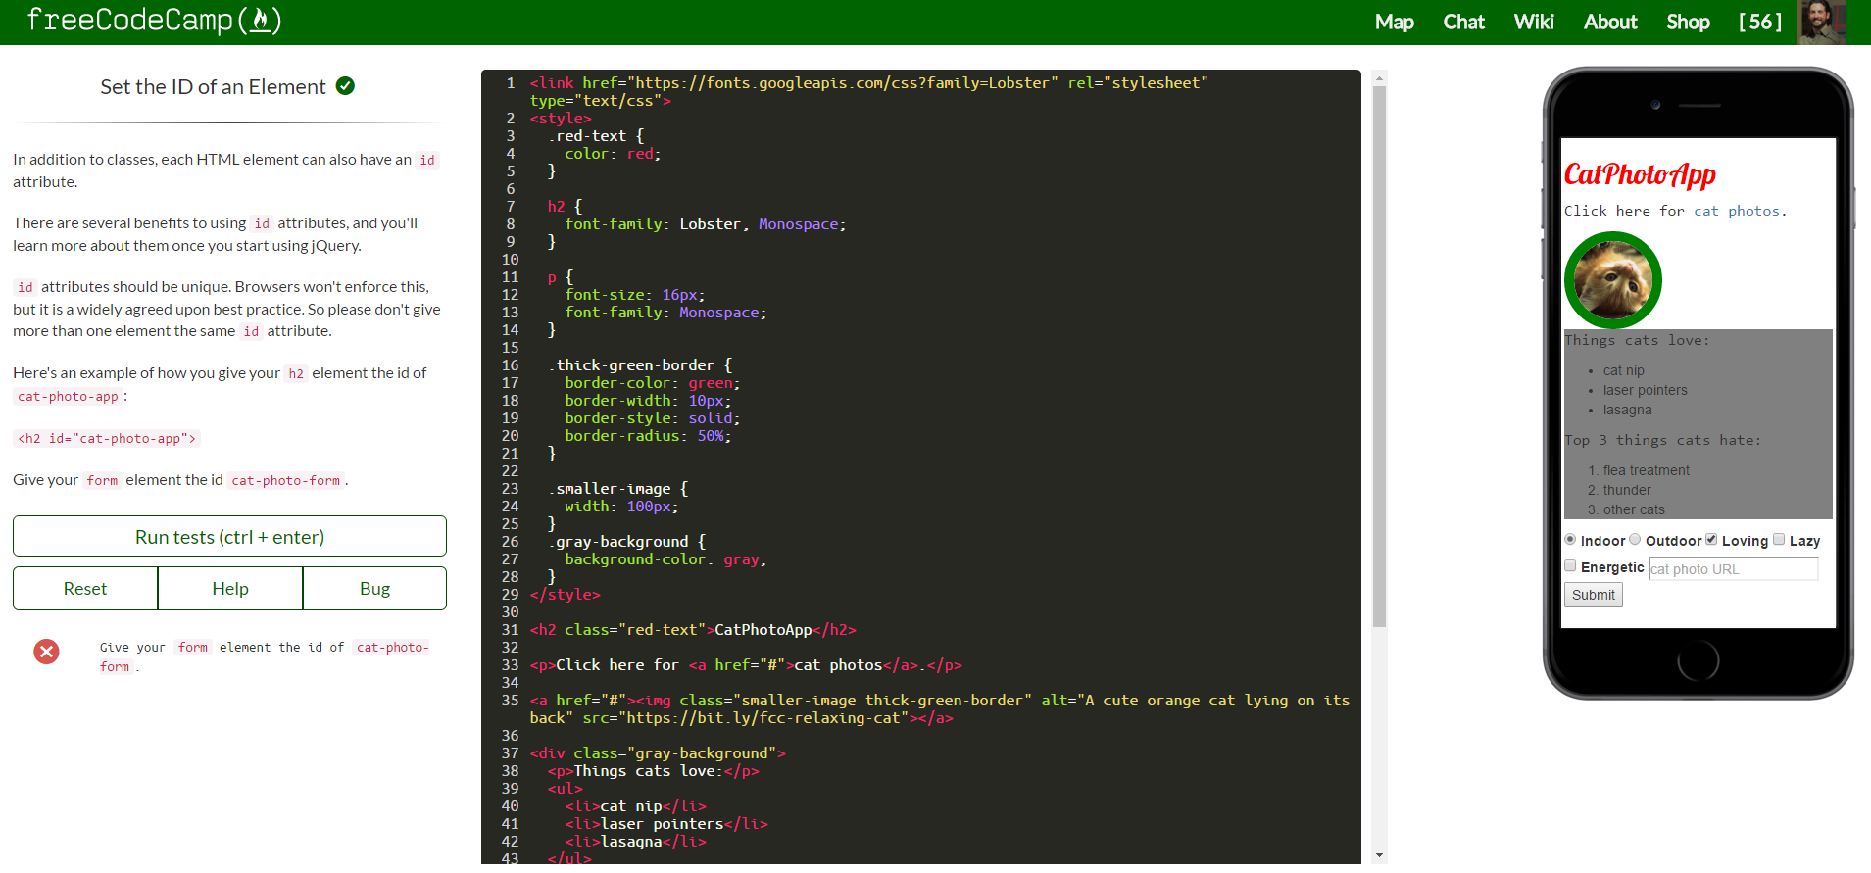
How it works

Slide 28
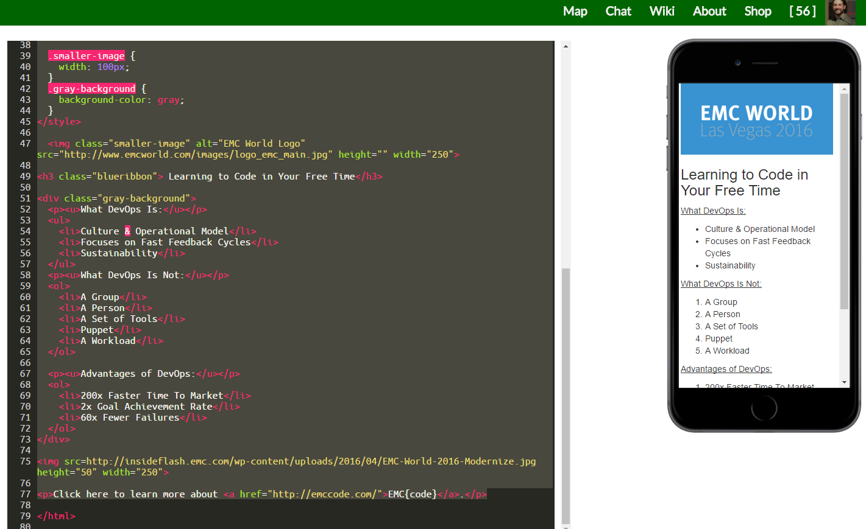
How I used it

Slide 29
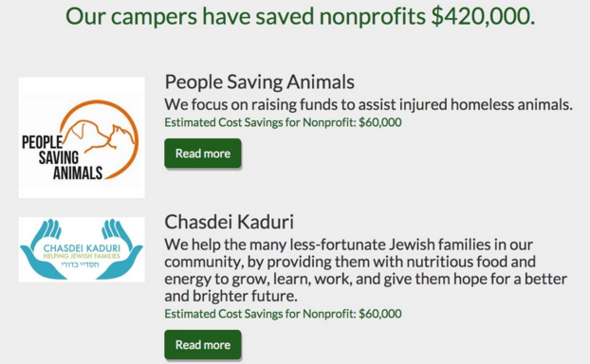
Why I chose them

Slide 30
What does this all mean?
Get Educated
Get Uncomfortable
Get Invigorated
Get Involved
“If you don’t like change, you will like irrelevancy even less”
-General Eric Shinseki, US Army

Slide 31



